Slide 1

FOOD REVIEWS AND RATINGS
TEAM-15
19K41A05C8
19K41A05D0
19K41A05D6

Slide 2
INTRODUCTION
Natural Language Processing (NLP) is a field of computer science and linguistics concerned with the interactions between computers and human (natural) languages.
With the growth of web we can find a number of reviews or opinions on any product in many website.
Customer spends a lot of time looking for the right product based on the feedback the knowledgeable people share.
So, we've created a model that will rate the review given food accordingly and it is easy to make decisions .

Slide 3
OBJECTIVE
The main objective of this study is to classify customer reviews and rate the food according to the review.
To measure the intensity of the sentiments generated from the customer reviews
To analyze the association between customer reviews and food they reviewed.

Slide 4
BENEFITS:
By analyzing the data collected about the food review from the online platforms,we can conclude that they were many opinions on the food according to the recipe.
These insights are very important because you can use them to dig deeper into the roots of these issues in order to improve and choose the best food.

Slide 5
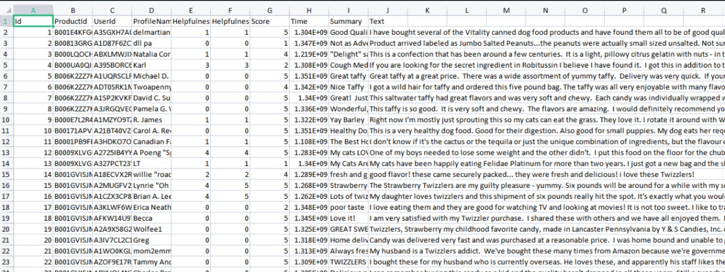
DATASET

Slide 6
DATASET
A collection of dataset for food review contains product id , user id ,rating and review/summary.
We collected dataset from internet sources.

Slide 7
DATA PRE-PROCESSING TECHNIQUES:
In order to maintain the proper processing of model,we applied-
Tokenizaton
Stemming
Removing Punctaution
Removing Stop Words

Slide 8
MODELS
In the food review and rating, we used NLP model.
In this, we used two models namely:
1.Word2Vec
2. LSTM (LONG SHORT TERM MEMORY)

Slide 9
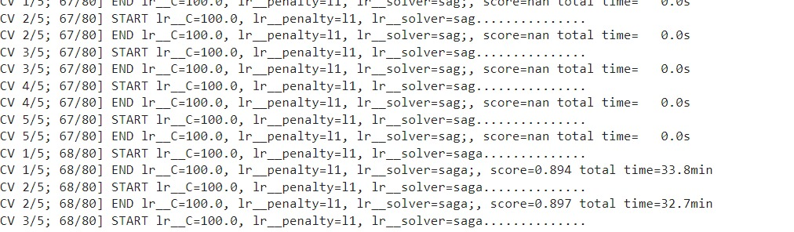
RESULTS:

Slide 10
CONCLUSION
To conclude, we have developed a NLP model using Word2Vec and LSTM algorithms with an accuracy of 89.7% .

Slide 11
REFERENCES:
1)[1] B. Prasad Majumder, S. Li, J. Ni, and J. McAuley, “Generating personalized recipes from historical user preferences,” Empirical Methods in Natural Language Processing (EMNLP), 2019. 5
2)[2] M. Harvey, B. Ludwig, and D. Elswiler, “You are what you eat: Learning user tastes for rating prediction,” Lecture Notes in Computer Science, 2013.
3)[3] J. Freyne and S. Berkovsky, “Intelligent food planning: personalized recipe recommendation,” 2010.
4)[4] C.-Y. Teng, Y.-R. Lin, and L. Adamic, “Recipe recommendation using ingredient networks,” 2012.
5) [5] X. Mao, R. Yanghui, and Q. Li, “Recipe popularity prediction based on the analysis of social reviews,” 2013.
6) [6] J. Devlin, M.-W. Chang, K. Lee, and K. Toutanova, “Bert: Pre-training of deep bidirectional transformers for language understanding,” in North American Chapter of the Association for Computational Linguistics, 2019.
7)[7] https://www.irjet.net/archives/V7/i3/IRJET-V7I3387.pdf
8)[8] https://www.researchgate.net/publication/348603412_Sentiment_Analysis_for_Rating_Cooking_Recipes_Based_on_User%27s_Feedback_Using_Data_Mining_TechniquesClassification
9)[9] https://nevonprojects.com/cooking-recipe-rating-based-on-sentiment-analysis/
[10] https://www.irjet.net/archives/V7/i3/IRJET-V7I3387.pdf

